Slide 1
Land cover map
Jan 31, 2018

Slide 2
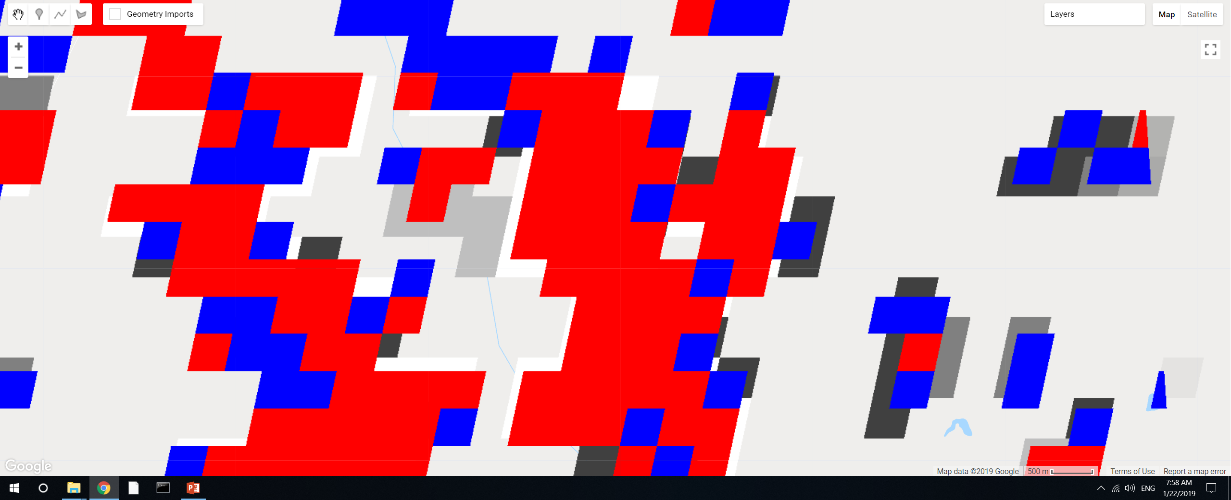
GEE file: LandCover/Soy Classification Masking
Added a small section of code to explore specifics of connectedPixelCount. Red is DC, blue is SC, underlying layer is the ‘count’ from connectedPixelCount, the areas that are not covered by red or blue are class 2 (other agri).
Use 4-connected only. The ‘connection’ is not only for adjacent pixels. So if a ‘red’ pixel is sticking out by itself but it’s connected to a large chunk of ‘red’ pixels, its connected pixels will still be high.
The values of the pixels should be integers. If they’re integers, don’t need to separately mask out DC vs SC; the connected pixels will automatically count only SC or only DC.
If pixels look like they’re only partially masked, it’s probably because they’re masked with a different map. The result of exporting an image should produce whole pixels, though the exact location of the pixels might be mismatched.

Slide 3
Searching for commercial high resolution satellite imagery
Requested quote from Satellite Imaging Corp (QuickBird) – but was directed to PlanetLabs
Search for images on LandInfo. Available images to search are:
GeoEye-1
WorldView-1, to -4
QuickBird
IKONOS
SPOT 1- 7
RapidEye
PlaneteScope/Dove
Planet Labs satellites: which ones?

Slide 4
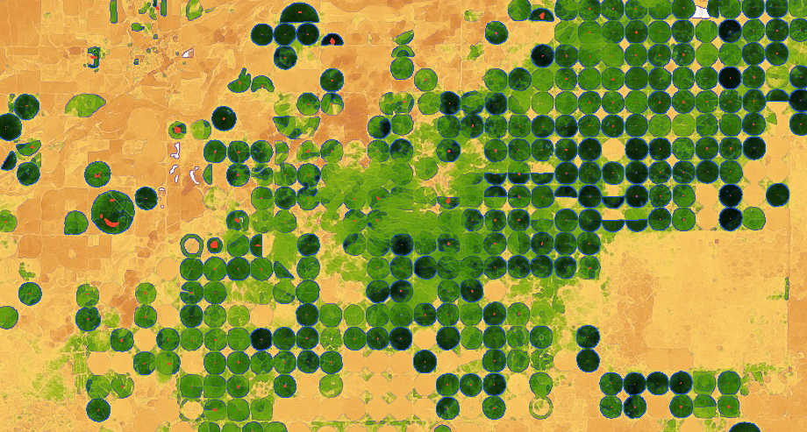
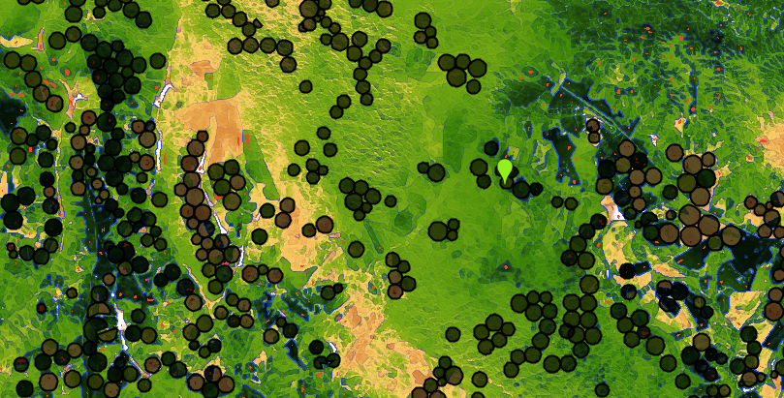
Center Pivot detection
In GEE: LandCover/Center Pivot Classification
Method is based on edge detection. Red = ‘center pivot’. Blue = detected edge. Black circles = 2014 center pivot data
Kansas, using Landsat 8 day EVI in April 2013
Mato Grosso, using Landsat 8 day EVI in April 2013
Observations:
Mato Grosso’s center pivot timing varies dramatically across short spans (i.e. some center pivot is yellow while others are green) – maybe need Landsat images at different times of year
Irregularly spaced center pivot and heterogeneous natural vegetation make it hard to pinpoint actual center pivot (problem for edge detection)
As-is, natural vegetation is very often misclassified as center pivot because of the edges.
Size of center pivots is very uniform in Kansas but more varied in Mato Grosso, is a problem for creating a single kernel size in edge detection

Slide 5
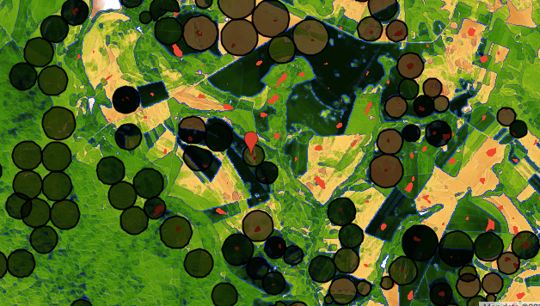
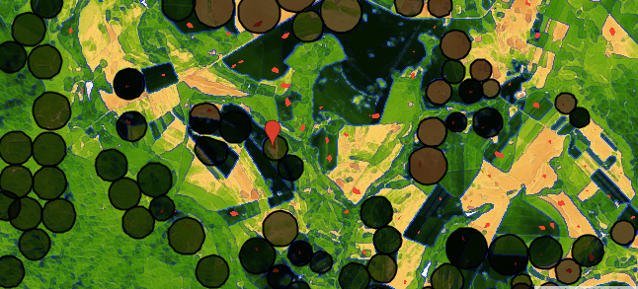
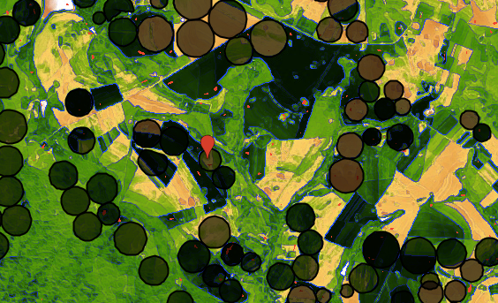
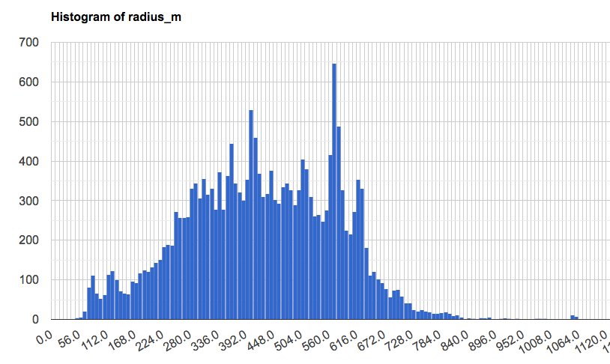
Center Pivot detection: sensitivity to size of kernel
In GEE: LandCover/Center Pivot Classification
Radius = 780m
Kernel size = 700m
Kernel size = 500m
Radius = 350m
Kernel size = 300m
Min: 5m
Max: 1300 m
Count
Center pivot radius [m]

Slide 6
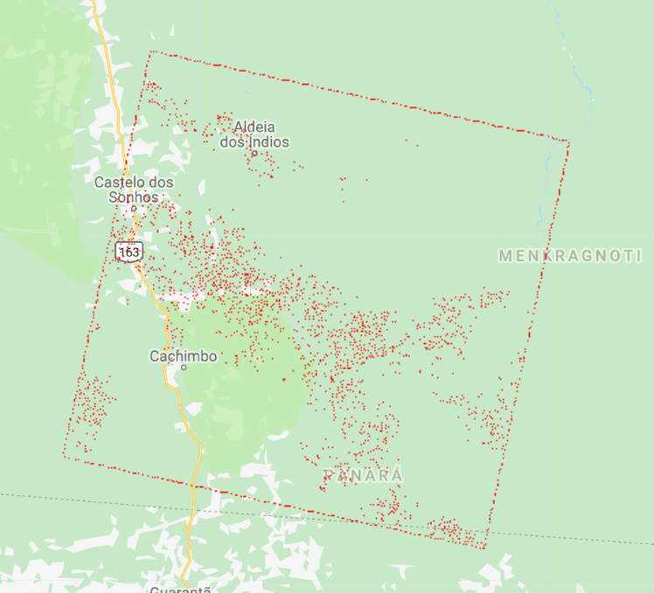
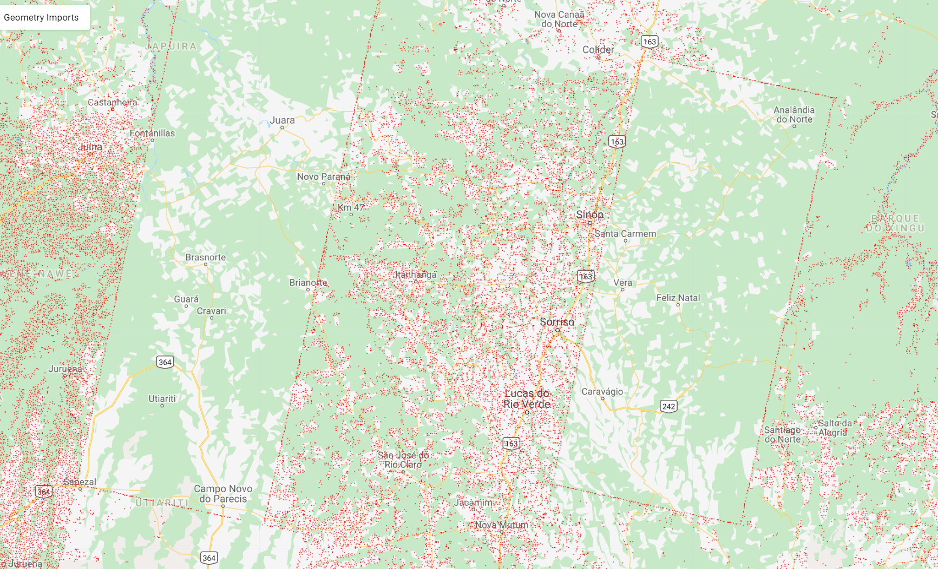
Center Pivot detection: edges of Landsat images are detected
In GEE: LandCover/Center Pivot Classification
Red = detected center of center pivot
To solve:
Get footprint/edges of Landsat image and mask it out
Neighborhood mean of pixels (but edge detection will be weaker)
Pattern detection in GEE
8 day composite
32 day composite

Slide 7
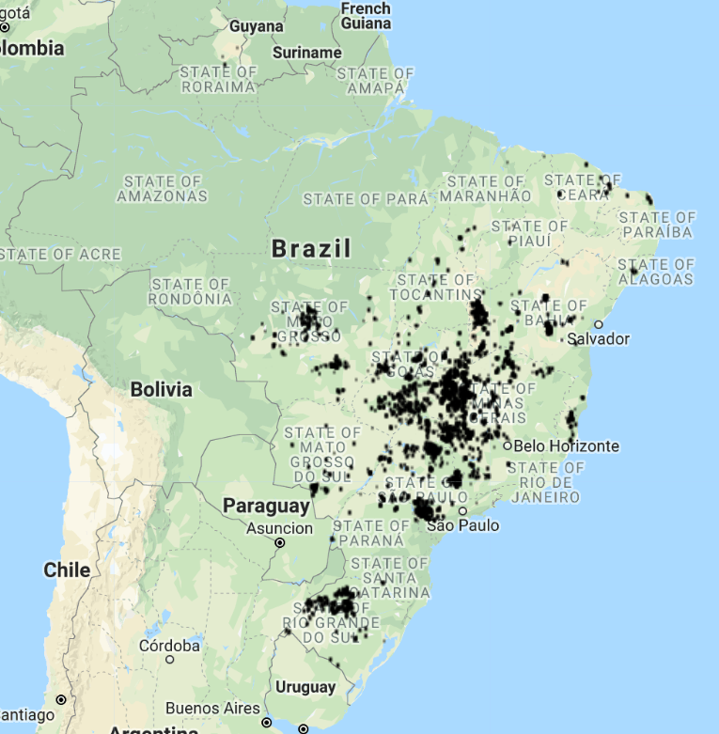
Center Pivot detection: set up accuracy detection method
In GEE: LandCover/Center Pivot Classification
Randomly select 10 center pivot locations in 2014
Take 150km2 polygon around the randomly selected center pivot
Do reduceToVector, clean up neighbors within 100m (computationally intensive!)
Check overlap/nonoverlap of centroids with reported 2014 center pivot depending on:
Kernel size(s)
Landsat 8 day vs 32 day
Date of Landsat image
Landsat image edge cleaning method
Location in Brazil
2014 reported center pivot

